Slide 1

Crisis Communication in the Niagara Region during the COVID-19 Pandemic
Archives Unleashed Cohorts Opening Meeting
July 13, 2021

Slide 2
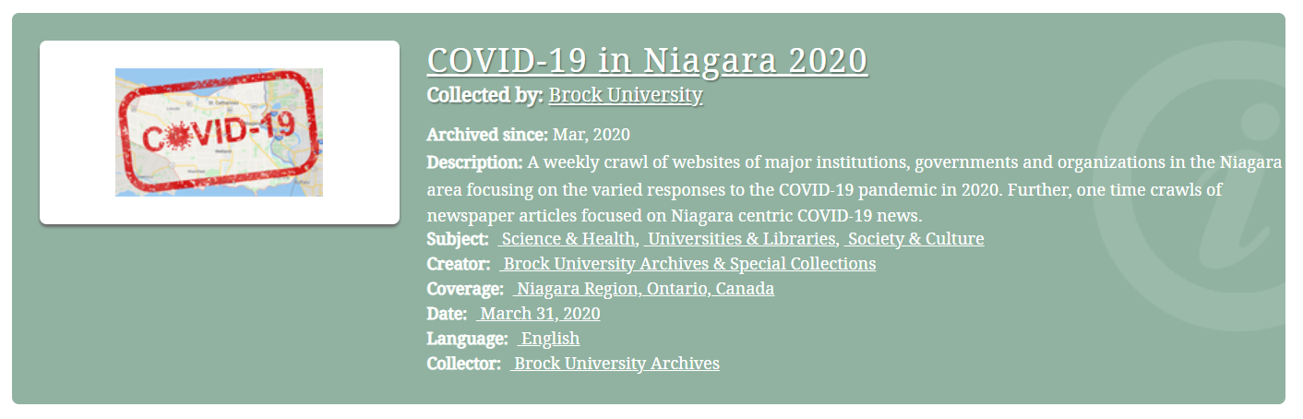
COVID-19 in Niagara Dataset
Since April 2020, the Brock University Archives have been capturing COVID-19 related webpages of major municipal governments, businesses and organizations in the Niagara region of Canada using Archive-It.
Notes:
David

Slide 3
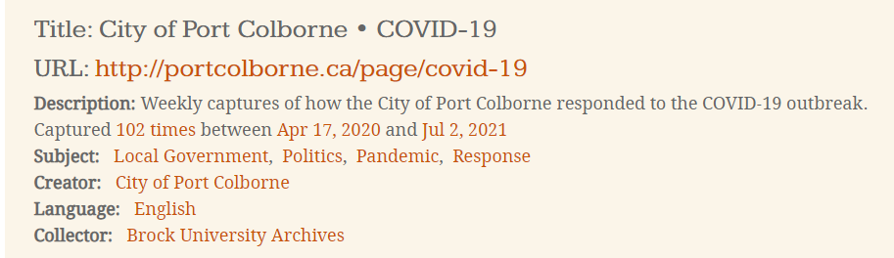
COVID-19 in Niagara Dataset
There are 56 key organizations that have been collected consistently over the past 15 months as well as local news articles about the pandemic.
To date, over 3 million documents have been archived totaling approximately 281 GB of data. And it will continue to grow into 2022.
Notes:
David

Slide 4
Crisis Communication
Effective crisis communication is vital for community resilience, education, trust, and engagement
Resilience = ability to bounce back after a crisis hits
Education = knowledge for citizens to act appropriately and reduce their risk
Trust = citizens find government/health care leaders trustworthy/credible
Engagement = government/health care leaders must create dialogue with citizens
Niagara Region organizations' pandemic communications important contributor to these four factors
Notes:
Duncan

Slide 5
Crisis Communication
Even though pandemic only began in winter 2020, some peer-reviewed research already published on how public organizations dealt with pandemic, but none about Canadian crisis management
Nothing published yet about role of organizational web sites
Even before pandemic, little published on public organizations and their use of media, particularly social media, in a major health crisis
General themes in this research: 1) social media engagement/education of citizens; 2) consistency/clarity of messaging; 3) role of emotions/empathy in pandemic communication (both leaders' and users')
Notes:
Duncan

Slide 6
Crisis Communication
Some questions we want to consider:
What are the similarities and differences between public and private organizational crisis communication during the pandemic?
Was there a unified voice across organizations on health measures, instructions for behaviour, etc.?
What was the emotional character of pandemic messaging from Niagara Region organizations?
Did messaging change over time as pandemic circumstances changed? If so, in what ways?
Did messaging change in step with government mandates? If so, what was the delay/lag?
Notes:
Duncan

Slide 7


Teaching with Archives Unleashed Material
The CPCF department at Brock offers a fourth year undergraduate seminar called Data & Society (Comm 4P35)
Anticipated enrolment is 25 student
In fall 2021, the course will prototype a learning activity with AU data
Draft Concept:
In the form of case study, students will be asked to explore how non-profit service models for vulnerable community members (e.g., homeless individuals, newcomers, etc.) were communicated during the pandemic to educate service users to stay safe
Notes:
Karen

Slide 8
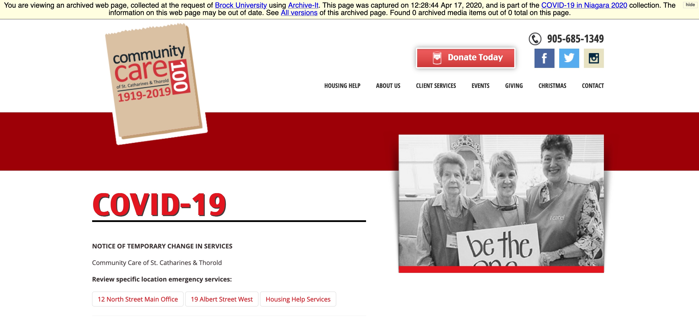
Teaching with Archives Unleashed Material
Example from the data set: Community Care Niagara provides food bank, housing help and other critical services
The Community Care Covid-19 page was archived 87 time (to date) through Brock's Covid-19 in Niagara 2020 Collection
A sub-data set of Community Care and other non-profit organization will be aggregated
​ (target 5-10 organizations; 435-870 webpages )
Students in Comm 4P35 will query data to locate how terms like 'social distancing' or 'masking' emerge temporally across the archived pages that describe precautions necessary to deliver vital community services
Notes:
Tim & Cal

Slide 9



Teaching with Web Archives Cont'd

Slide 10
Teaching with Web Archives Cont'd
A serious bottleneck in web archives use and adoption is training students and researchers
Library-sponsored, scaffolded workshops using Google Collab and the COVID19 in Niagara Dataset

Slide 11
References & Image Credits
Vaccination Arena Image https://twitter.com/niagarahealth/status/1408104158666833920
COVID-19 in Niagara public Archive-It page - https://archive-it.org/collections/13781
Community Care homepage https://wayback.archive-it.org/13781/*/http://www.communitycarestca.ca/COVID-19/

